Slide 1

RISK AND RESILIENCE BOOTCAMP
2
Notes:
https://www.ncsc.gov.uk/static-assets/documents/PwnedPasswordsTop100k.txt

Slide 2


Slide 3


ISACA and DRI Frameworks
In addition to preparing you to work in the areas of risk and resilience on the job
  ISACA: International Systems Audit and Control Association
    Provides risk management certification
  DRII: Disaster Recovery Institute International
    Certifies resilience professionals
This module review some of the areas covered by these certifications

Slide 4
ISACA Framework
The latest ISACA framework is integrated into the risk management materials in this course
  However, we will also be looking at relevant risk and resilience management issues as well as other related topics beyond the scope of ISACA
  In this section we will align some of the informal ideas on risk from the last module with sections in the framework
  As we go through the course, we will be referring to relevant concepts and sections in the framework

Slide 5
ISACA Framework
The main areas covered by the ISACA framework are
  Introducing the Risk IT Framework
    The imperative for Risk IT
    Definitions and terminology
    Purpose of the Risk IT Framework
    Target audience and stakeholders
  Risk IT Framework principles
    Connect to enterprise business or mission
    Align with enterprise risk management
    Balance costs and benefits
    Promote ethical and open communication
    Establish tone at the top and accountability
    Use a consistent approach aligned to strategy

Slide 6
ISACA Framework
  Framework components and alignment with COBIT
    Components of the Risk IT Framework
    Alignment of COBIT with the Risk IT Framework
    Application of the RISK IT Framework independent of COBIT
  Essentials of risk governance
    Risk appetite, tolerance and risk capacity
    Stakeholders of IT risk management
    Risk culture
  Essentials of risk management
    Setting the context and scoping risk management
    Understanding the risk management workflow

Slide 7
ISACA Framework
  Essentials of risk assessment
    Risk identification
    Risk analysis
    Evaluating the business impact of identified risks
    IT risk scenarios
  Risk awareness, reporting and communication
    Benefits of risk awareness and communication
    Risk reporting and communication
    Key risk indicators

Slide 8
ISACA Framework
  Essentials of risk response
    Risk avoidance
    Risk mitigation
    Risk sharing or transfer
    Risk acceptance
    Risk aggregation
    Risk response selection and prioritization
We have already touched on several of these in the last section
  That was a more intuitive orientation
In this and the modules that follow
  We will introduce the ISACA framework concepts where appropriate

Slide 9
DRI international best practices
Publishes a lifecycle framework
  Called the Professional Practices for Business Continuity Management
  It’s the BCM/resilience counterpart to ISACA’s Risk IT
  A structured body of knowledge used to build, run, test, and improve an enterprise resilience program
What the DRI framework covers (the 10 Professional Practices)
  Program initiation and management
    Establish the need for a business continuity program
    Obtain support and funding for the business continuity program
    Build the organizational framework to support the business continuity program
    Introduce key concepts, such as program management, risk awareness, identification of critical functions/processes, recovery strategies, training and awareness, and exercising/testing

Slide 10
DRI international best practices
  Risk assessment
    Identify risks that can adversely affect an entity’s resources or image
    Assess risks to determine the potential impacts to the entity, enabling the entity to determine the most effective use of resources to reduce these potential impacts
  Business impact analysis
    Identify and prioritize the entity’s functions and processes in order to ascertain which ones will have the greatest impact should they not be available
    Assess the resources required to support the business impact analysis process
    Analyze the findings to ascertain any gaps between the entity’s requirements and its ability to deliver those requirements
  Business continuity strategies
    Select cost-effective strategies to reduce deficiencies as identified during the risk assessment and BIA

Slide 11
DRI international best practices
  Incident response
    Develop and assist with the implementation of an incident management system that defines organizational roles, lines of authority and succession of authority
    Define requirements to develop and implement the entity’s incident response plan
    Ensure that incident response is coordinated with outside organizations in a timely and effective manner when appropriate
  Plan development and implementation
    Document plans to be used during an incident that will enable the entity to continue to function
  Awareness and training programs
    Establish and maintain training and awareness programs that result in personnel being able to respond to incidents in a calm and efficient manner

Slide 12
DRI international best practices
  Business continuity plan exercise, assessment, and maintenance
    Establish an exercise, assessment and maintenance program to maintain a state of readiness
  Crisis communications
    Provide a framework for developing a crisis communications plan
    Ensure that the crisis communications plan will provide for timely, effective communication with internal and external parties
  Coordination with external agencies
    Establish policies and procedures to coordinate incident response activities with public entities

Slide 13
overlap
There are clearly some overlaps between the two frameworks
  ISACA focuses on categorizing and governing IT risk end to end
    Looks at benefit/value, program/project delivery, operations/security
    Provides risk terminology and an oversight model
  DRI focuses on continuity and resilience execution
    Derives targets (via BIA/risk), chooses strategies, implements plans, trains, exercises, and keeps improving
Integration
  Use ISACA to frame and report risk (governance, appetite, domains).
  Use DRI to operationalize resilience into actions
  This pairing reflects how banks are examined today
  Consistent with ISO’s organizational-resilience guidance.

Slide 14
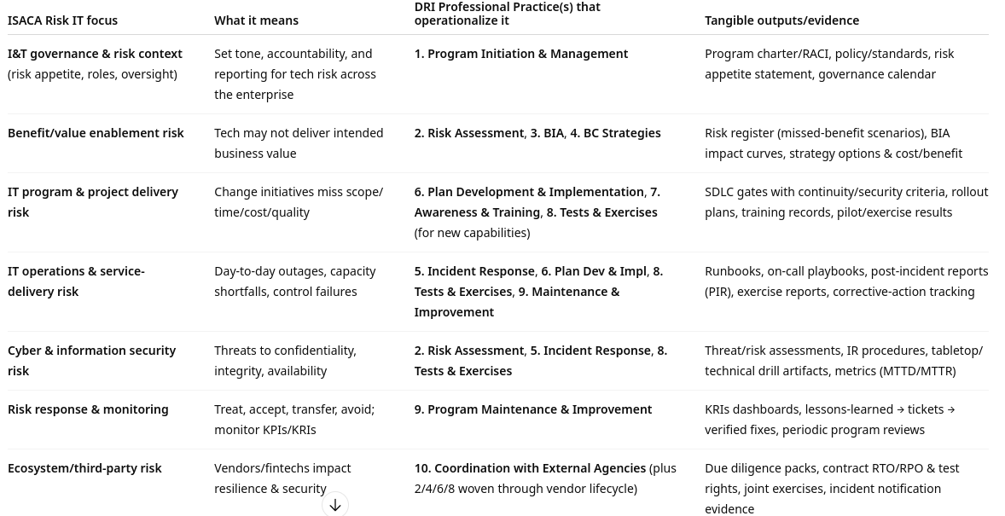
integration

Slide 15
COBIT
Referenced in the framework
  COBIT (Control Objectives for Information and Related Technologies)
    ISACA’s framework for the governance and management of enterprise IT
    It gives boards, executives, and technology leaders a common language, a set of objectives, and practical components to ensure IT creates value, manages risk, and achieves compliance
  What COBIT is for
    Governance: Set direction, evaluate options, and monitor results so IT supports business goals
    Management: Plan, build, run, and monitor IT services and change programs in a controlled way
    Assurance & alignment: Map policies, controls, and metrics across other standards (NIST CSF, ISO/IEC 27001)

Slide 16
COBIT structure
Principles
  For governance systems
  Tailored to enterprise needs and end-to-end coverage
Objectives model
  Governance objectives (EDM): Evaluate, Direct, Monitor.
  Management objectives grouped into domains:
    APO – Align, Plan, Organize (strategy, risk, architecture, sourcing).
    BAI – Build, Acquire, Implement (change, projects, configuration, release).
    DSS – Deliver, Service, Support (operations, continuity, security ops, incident/problem).
    MEA – Monitor, Evaluate, Assess (performance, compliance, internal control).

Slide 17
COBIT structure
Components (“enablers”)
  Processes, organizational structures
  Policies and procedures
  Information
  Culture/behavior
  People and skills
  Services/infrastructure/applications
Performance management
  Maturity/capability levels and metrics to track whether objectives are being met

Slide 18
COBIT
Reasons for risk/resilience teams to use COBIT
  Clear ownership
    Ties controls to specific objectives
  Evidence-ready
    Points to artifacts examiners expect
    Risk register
    BIA/RTO-RPO
    Change tickets
    Restore tests
    KRIs
    Compliance reports
  Bridging frameworks
    Shows how the NIST/ISO/ITIL controls collectively satisfy governance expectations for regulators and internal audit

Slide 19
COBIT
COBIT is the top-level operating model for IT governance and control
  Used to
    Assign ownership
    Select and align controls
    Measure performance
    Demonstrate that technology risk and resilience are managed systematically across the enterprise

Slide 20
ISACA framework
A structured, systematic methodology that enables enterprises to:
  Identify current and emerging risks throughout the extended enterprise
  Develop appropriate operational capabilities to ensure that business processes continue operating through adverse events
  Leverage investments in compliance or internal control systems already in place to optimize I&T-related risk
  Recognize I&T-related risk that exceeds the scope of technical controls and IT-related tools and techniques to integrate into the enterprise risk management (ERM) program

Slide 21
ISACA framework
Continued
  Raise awareness of the balance between the benefits of technology and external partners (on the one hand), and the potential impact of cyberthreats, internal control failures, and risk introduced by vendors, suppliers and partners on the other hand
  Promote risk awareness, accountability and responsibility throughout the enterprise
  Frame I&T-related risk within a business context to understand aggregate exposure in terms of enterprise value
  Focus internal and external risk management resources to maximize enterprise objectives
Alignment
  Aligns with major ERM frameworks including (we will examine these later on)
    The COSO ERM framework
    ISO 31000 Risk Management standard

Slide 22
ISACA Definitions
To be consistent with the ISACA, we will use their definitions from this point on
  Enterprise
    A group of individuals working together for a common purpose, typically within the context of a business organization, such as a corporation, partnership, limited liability company, government or public agency, charity, nonprofit or trust
  Organization
    The structure or arrangement of interrelated components of an enterprise, defined by a particular scope
  Business or mission
    The strategic purpose for which the organization exists
    In the scope of risk IT, an enterprise typically sets strategic objectives. such as delivering a product or service, meeting sales targets and generating revenue
    The purpose of a mission-driven organization may be similar to a business enterprise, but often operates to meet a mission, or nonprofit objectives

Slide 23
ISACA Definitions
  Governance
    The framework and system ensuring that:
    Stakeholder needs, conditions and options are evaluated to determine balanced, agreed-on enterprise objectives
    Strategic direction is set, and goals are prioritized and supported through appropriate, timely decision making
  Risk
    The combination of the likelihood of an event and its impact
  Information security
    The enterprise discipline that protects information against disclosure to unauthorized users (confidentiality), improper modification (integrity), and non-availability when required (availability)

Slide 24
Framework Integration View
Purpose of integration
  The two domains complement each other to provide a more complete solution to managing, controlling and responding to potential risk and risk related events
    ISACA = governance lens: defines IT risk terminology, appetite, tolerance, and alignment with business strategy
    DRI = execution lens: operationalizes resilience with lifecycle practices (assessment, BIA, incident response, testing, improvement)
  ISACA focuses on categorizing and governing IT risk end-to-end
    Value delivery, project delivery, operations, security
  DRI focuses on continuity and resilience execution
    Identify risks, perform BIAs, select strategies, develop and exercise plans, communicate, and coordinate externally
  ISACA tells you what needs to be governed and reported.
  DRI tells you how to operationalize resilience actions.

Slide 25
Organizational Culture
Culture issues in resilience and risk management
  Resilience and risk management are not just technical, they are organizational
  Systems and plans only work if the people in the enterprise value risk awareness, act responsibly, and follow through in a crisis
  Risk assessments are useful only when they are acted on
  Culture influences how risks are identified, reported, and addressed before they escalate

Slide 26
Tone at the top
Tone at the Top
  Defined as the attitude and actions of senior leadership toward governance, ethics, and risk management
    Sets the standard for acceptable behavior across the organization
    When executives model accountability and openness, employees are more likely to report issues and follow controls
    When leadership ignores or downplays risks, resilience suffers; incidents are hidden, controls bypassed, and recovery delayed
  Elements of risk aware and resilient culture
    Risk awareness: employees understand how their role affects risk and recovery
    Accountability: clear ownership of controls, incidents, and recovery actions
    Open communication: safe channels to escalate problems without fear
    Continuous learning: post-incident reviews are used to improve, not blame
    Ethics and trust: trust in leadership decisions builds collective commitment to recovery

Slide 27
Tone at the top
Organizations with a strong resilience culture recover faster because employees already know
  What matters, who decides, and how to act under stress

Slide 28

Q&A and open discussion
Notes:
Now is the time to engage in an interactive Q&A session where you can ask questions, share insights, and clarify any doubts about the topics we have covered so far.
This open discussion is designed to ensure that every participant has the opportunity to voice their thoughts and learn from the collective experience of the group.
Your questions and comments are valuable as they help us identify areas that may need further explanation and enable us to tailor future sessions to your needs.
We encourage you to speak up and contribute to the dialogue, as this interaction is one of the key components of our interactive learning approach.
As the session progresses, take note of any questions or ideas that you would like to revisit, and feel free to share your perspectives with the class.

